Slide 1

Apache Kudu
fast analytics on fast data

Slide 2
Abstract:Kudu Feature
structured data schema
Both low-latency random access
And efficient analytical access

Slide 3
Problems without kudu
Static data usually stored on HDFS using binary data formats like Parquet, but it doesn’t provide way for updating individual record or efficient random access.
Mutable data usually stored in semi-structured stores such as Hbase or Cassandra. These systems allow for low-latency record-level reads and writes, but lag far behind the static file formats in terms of sequential read throughput for applications such as SQL-based analytics or machine learning.

Slide 4
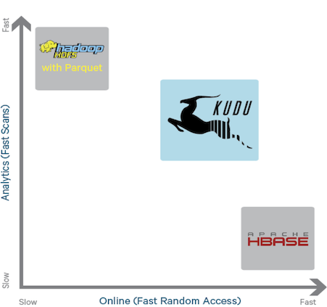
Kudu offers a “happy medium” alternative that can simplify the complex architecture such as Hive + HDFS + Hbase

Slide 5
Kudu Data Model
A Kudu cluster stores tables look like tables you're used to from relational (SQL) databases.
Each table has a primary key (one or more columns)
Rows can be efficiently read, updated, or deleted by their primary key.
The data model is fully typed

Slide 6
Low-latency random access
Kudu is a live storage system which supports low-latency millisecond-scale access to individual rows.
Provide C++ ,Java and Python APIs

Slide 7
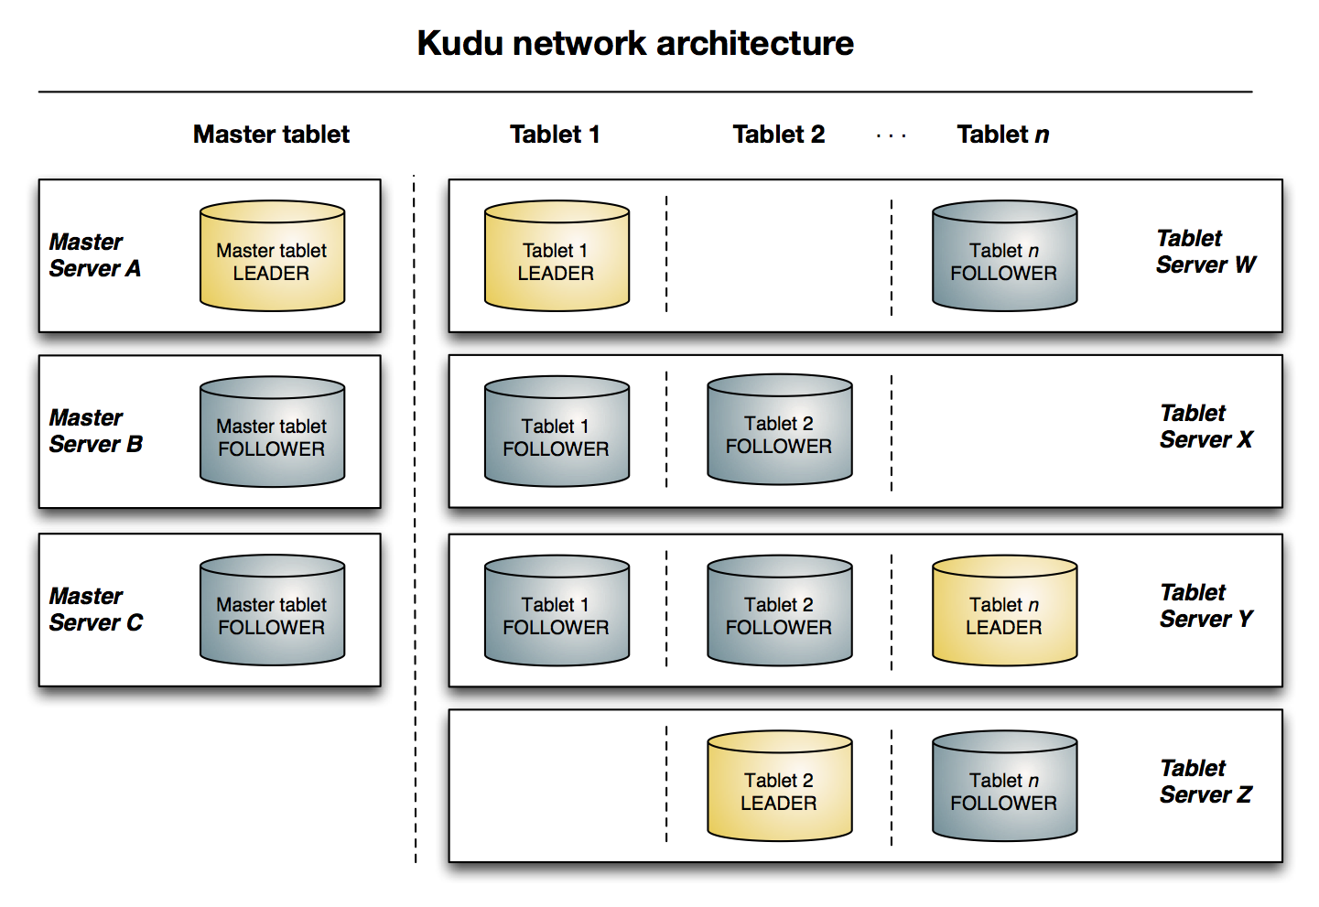
Kudu Architectural
A example with
three master and four tablet
servers.
Use raft consensus algorithm on
both master and server.

Slide 8
Installing Kudu
I use five c3 machines to install kudu . including one master and five tablet server. Operate System is centos7.
Something before install…
1 the number of master should be odd.
2 NTP should be set in every machine
3 use yum to install cyrus-sasl-plain and lsb plugins

Slide 9
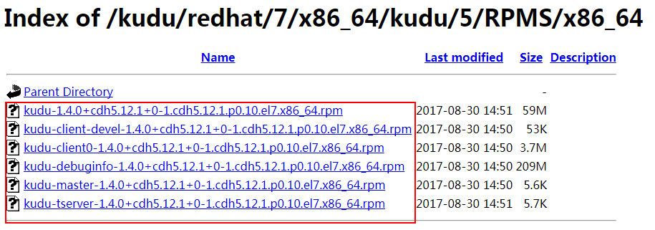
Installing Kudu
1 download the rpm file ,total six.

Slide 10
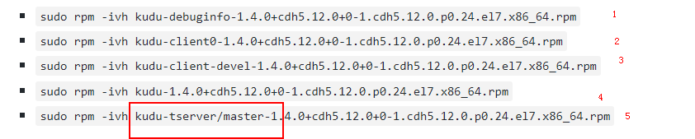
Installing Kudu
2 in the master/tserver machine

Slide 11
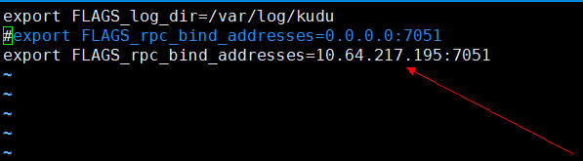
Installing Kudu
3 Required Configuration
First edit /etc/default/kudu-master in the master machine
Defalut is 0.0.0.0 ,change it to your master ip

Slide 12
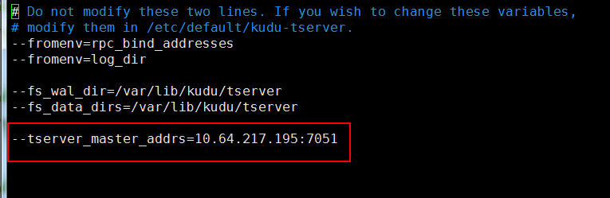
Installing Kudu
Second edit /etc/kudu/conf/tserver.gflagfile in the all tserver machine
Add your master addresses

Slide 13
Installing Kudu
Finally start/stop master and tserver
sudo service kudu-master start
sudo service kudu-tserver start
sudo service kudu-master stop
sudo service kudu-tserver stop
Access Web UI
masterIP:8551
tserverIP:8050

Slide 14

tips
In the controller operate
& kudu table list “master”
can show all tables
& kudu table delete “master” “tablename”
Can quickly delete a table

Slide 15
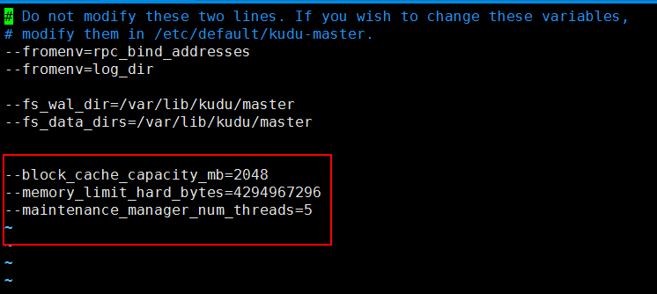
Configuring Apache Kudu
Edit master.gflagfile and tserver.gflagfile to Configure Kudu
Such as

Slide 16
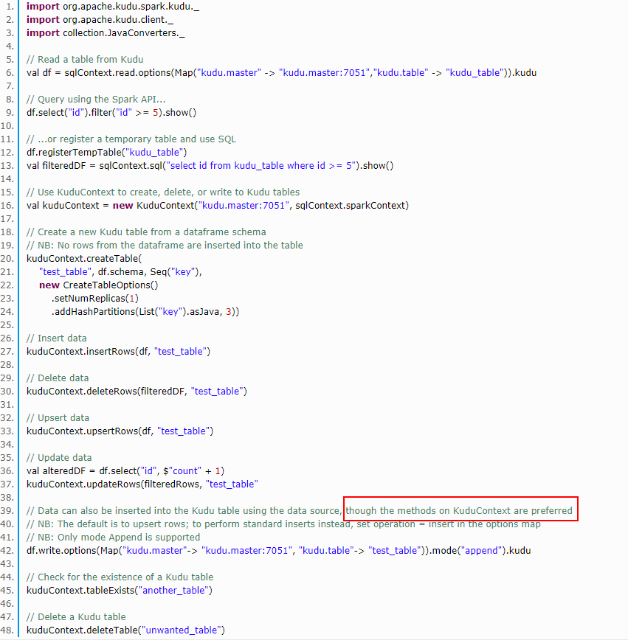
Developing Applications With Apache Kudu
For more examples you can see: https://github.com/xieenze/SparkOnKudu/blob/master/src/main/scala/com/spark/test/KuduCRUD.sc`ala

Slide 17
Kudu Schema Design
Supported column types include:
boolean
8-bit signed integer
16-bit signed integer
32-bit signed integer
64-bit signed integer
unixtime_micros (64-bit microseconds since the Unix epoch)
single-precision (32-bit) IEEE-754 floating-point number
double-precision (64-bit) IEEE-754 floating-point number
UTF-8 encoded string (up to 64KB uncompressed)
binary (up to 64KB uncompressed)

Slide 18
Kudu Schema Design
Tips
1 Columns that are not part of the primary key may be nullable
2 Kudu allows compression to be specified on a per-column basis.

Slide 19
Known Limitations
Number of Columns
By default, Kudu will not permit the creation of tables with more than 300 columns
Size of Cells
No individual cell may be larger than 64KB before encoding or compression.
Size of Rows
it is recommended that no single row be larger than a few hundred KB.
Immutable Primary Keys
Kudu does not allow you to update the primary key columns of a row.
Non-alterable Primary Key
Kudu does not allow you to alter the primary key columns after table creation.
Non-alterable Partitioning
Kudu does not allow you to change how a table is partitioned after creation, with the exception of adding or dropping range partitions.
Non-alterable Column Types
Kudu does not allow the type of a column to be altered.
Partition Splitting
Partitions cannot be split or merged after table creation.

Slide 20
Primary Key Design
Every Kudu table must declare a primary key index comprised of one or more columns.
Kudu does not provide an auto-incrementing column feature
Kudu’s primary key is a clustered index
Kudu does not currently offer secondary indexes or uniqueness constraints other than the primary key.

Slide 21
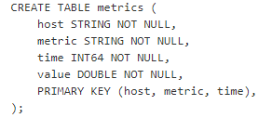
Partitioning Design
Kudu provides two types of partitioning: range partitioning and hash partitioning. Tables may also have multilevel partitioning, which combines range and hash partitioning, or multiple instances of hash partitioning.
Example:

Slide 22
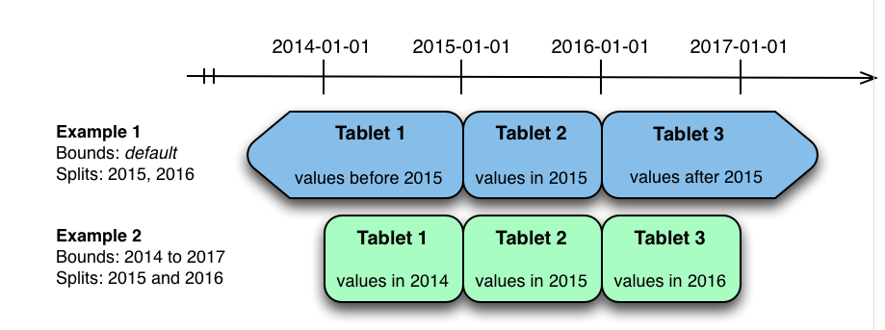
Range Partitioning

Slide 23
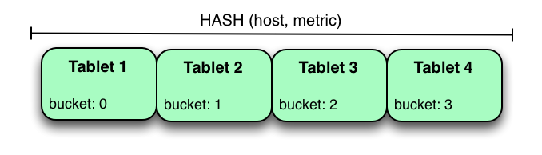
Hash Partitioning

Slide 24
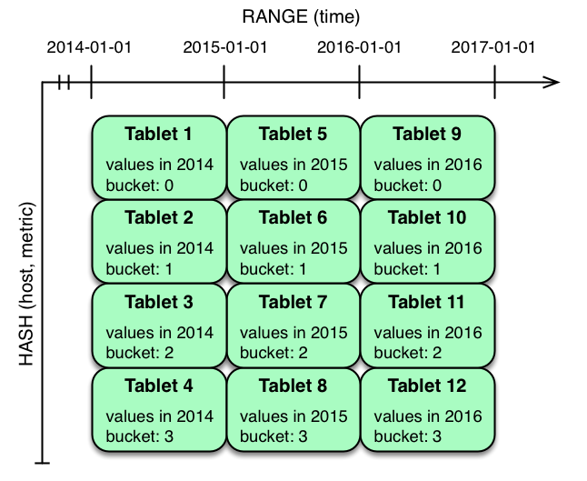
Hash and Range Partitioning

Slide 25
More information about primary key design and Partition
See: http://kudu.apache.org/docs/schema_design.html

Slide 26
Some info about Kudu’s paper
1 Currently, Kudu does not offer any multi-row transactional APIs
2 For large tables where throughput is important, we recommend on the order of 10-100 tablets per machine.

